Slide 1
CS584 Machine Learning Project Ticket malicious user identification
Team 2
By GangTao Zhou，Yuan Gao，Qi Fan

Slide 2
Background introduction
There will be some malicious users on the Online Travel Platforms.
They will use the loopholes of platforms and airlines to seek illegal interests and damage the rights and interests of normal users.
Our model hopes to find the characteristics of these malicious users on some problem users marked by experts, find and clean up these malicious users immediately, and protect the legitimate rights and interests of consumers.

Slide 3
Data introduction
User orders
Account info
Flight info
Device info
User browsing behavior

Slide 4
Algorithm selection
We will using Decision Tree to do supervised classification.
Use the marked problem users to calculate the identification characteristics of these problem users .
Finally the tree visualization and feature visualization are used to understand the overall situation of the risky users.

Slide 5
Process introduction
Define problem（Choose model）
Analysis data（View data distribution）
Prepare data （Feature Engineering，Training data，Test data）
Model training
Evaluation model

Slide 6
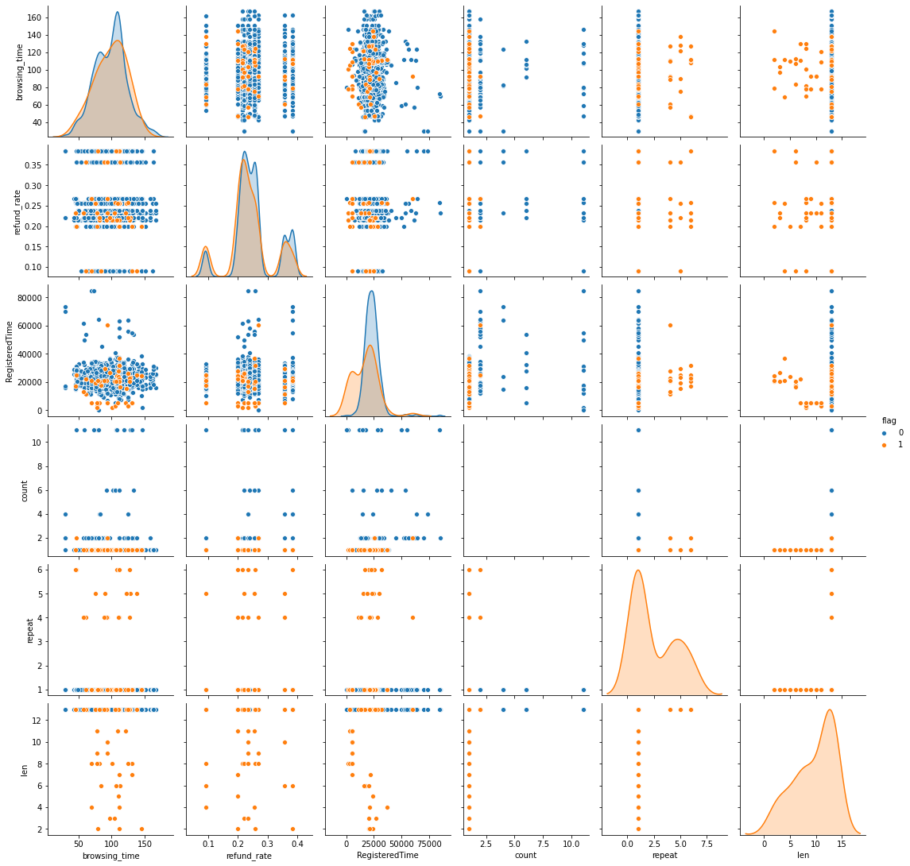
Analysis data
We have selected 6 features from the dimensions of orders and accounts that may help us identify malicious users.
By observing the data, we can find outliers or problems in the data in advance

Slide 7
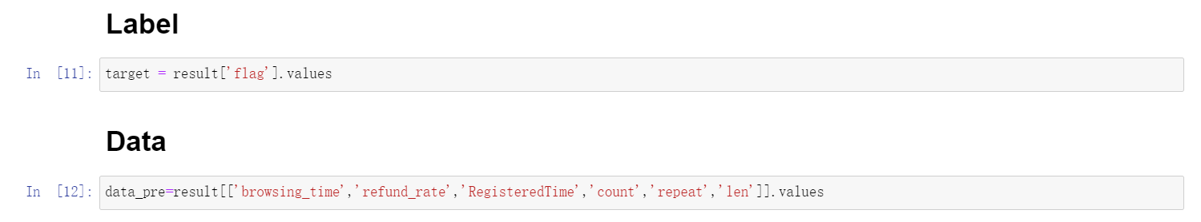
Prepare data
There are two main types of Supervised learning in machine learning problems, which are called classification and regression.
The goal of the classification task is to forecast category label.
The goal of the regression task is to predict a continuous value.
We choose the Decision Tree to classify and distinguish malicious users from normal users.
flag = 1 is a malicious user
flag = 0 is the normal user

Slide 8
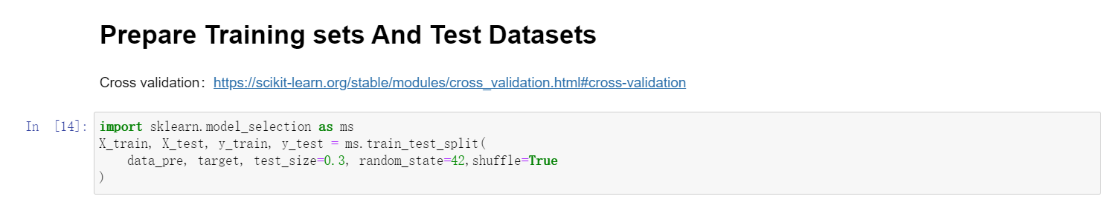
Prepare data
Split arrays or matrices into random train and test subsets.
Types:
Hold-out
Cross Validation（Mining as much information as possible from limited data）
BootStrapping（The self-help method is very useful when the data set is small and it is difficult to effectively divide the training set and the test set）
We choose Hold-out, 70% Training sets, 30% Test sets.

Slide 9
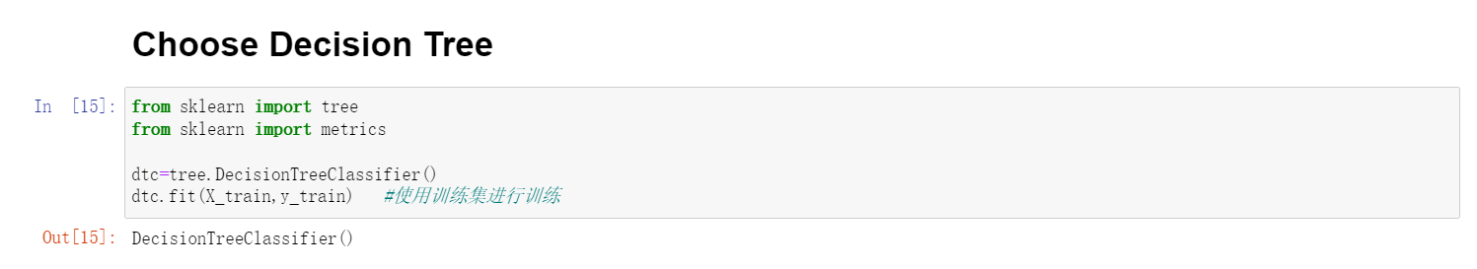
Model training
Supervised learning
Linear Models
Linear and Quadratic Discriminant Analysis
Kernel ridge regression
Support Vector Machines
Stochastic Gradient Descent
Nearest Neighbors
Gaussian Processes
Cross decomposition
Naive Bayes
Decision Trees (Choose）
Ensemble methods
Multiclass and multioutput algorithms
Feature selection
Semi-supervised learning
Isotonic regression
Probability calibration
Neural network models (supervised)

Slide 10
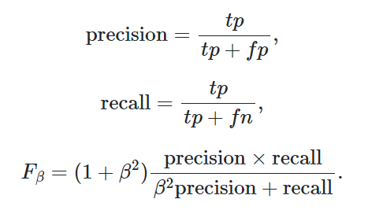
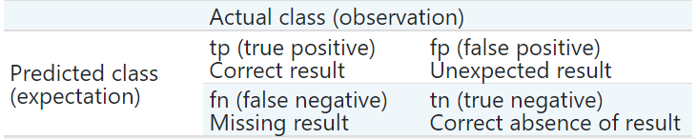
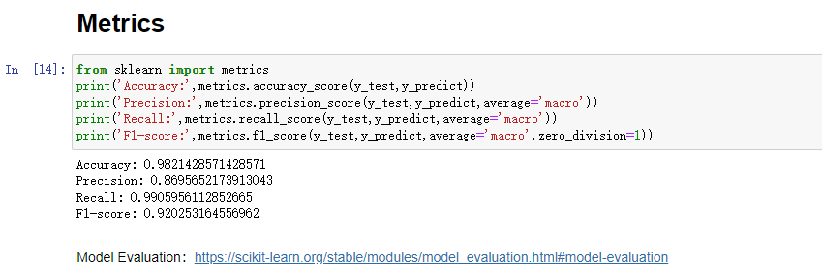
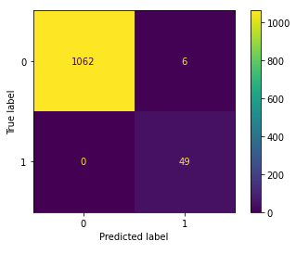
Evaluation model

Slide 11
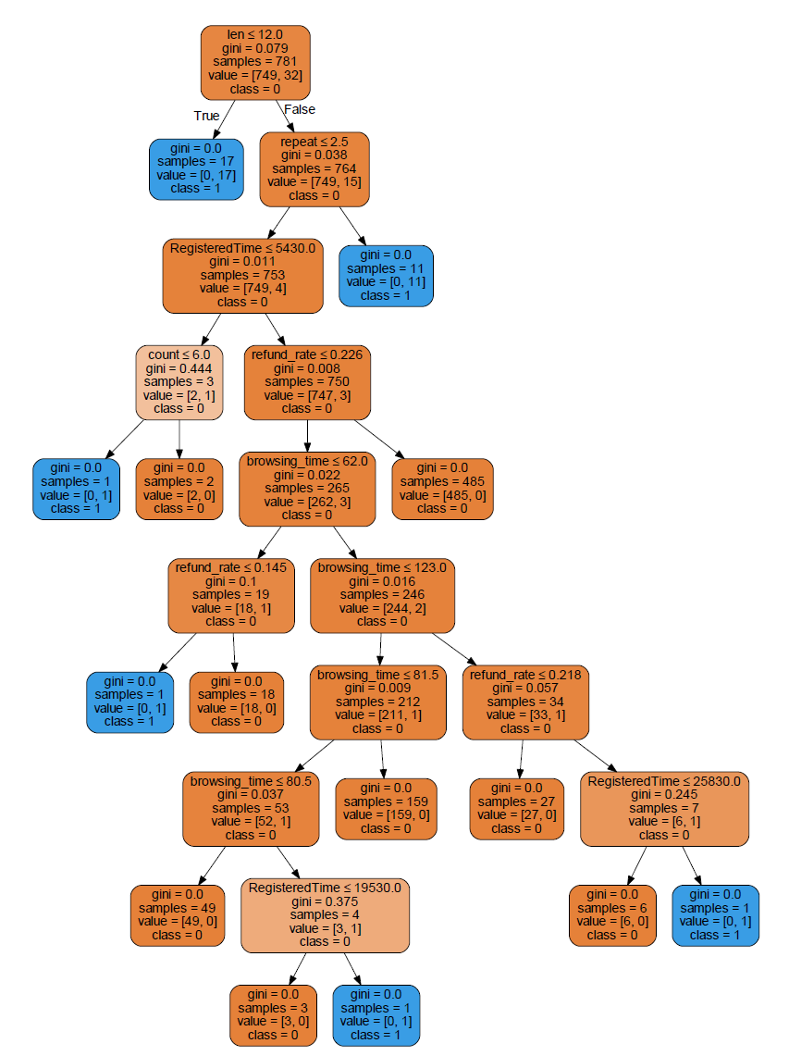
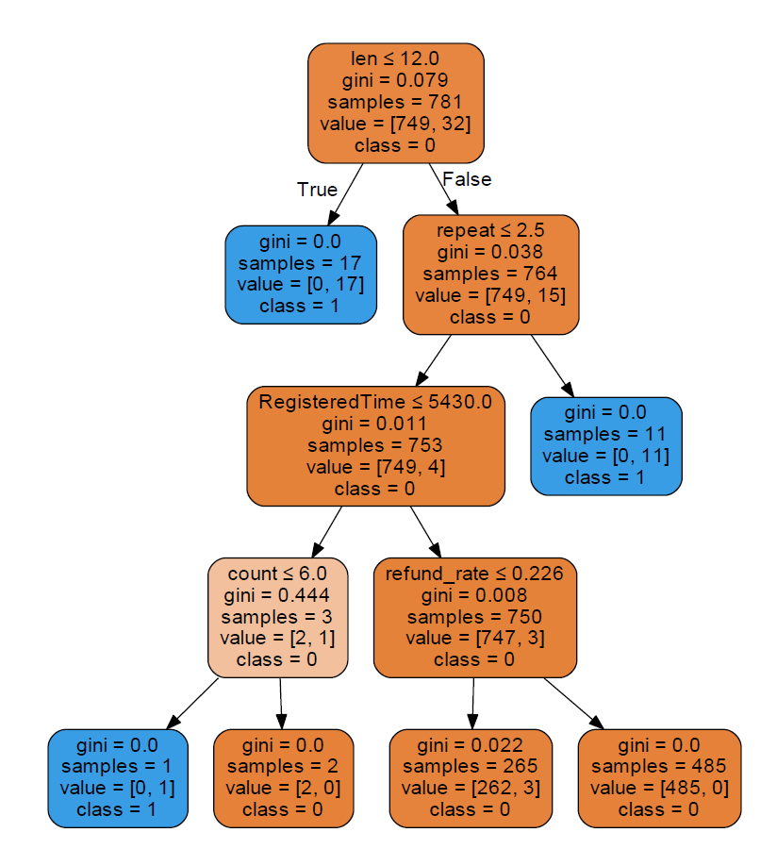
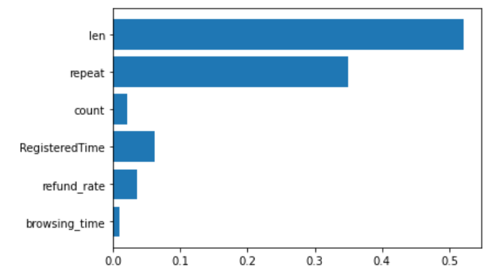
Analysis Tree
Through pre pruning and post pruning, the complexity of decision tree can be controlled to reduce the risk of over fitting.
We can control the depth of the tree and limit the number of leaf nodes.
Tree Graph
Tree (pre-pruning)
Feature Importance

Slide 12
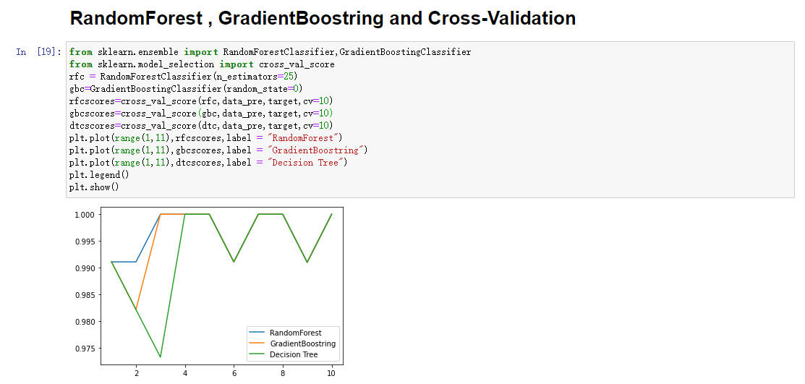
Try more
The main disadvantage of decision tree is that even if pre pruning is done, it is often over fitted and has poor generalization performance.
We can use the method of RandomForest or GradientBoostring to optimize the problem of over fitting the training data, improve the performance and accuracy of the model

Slide 13
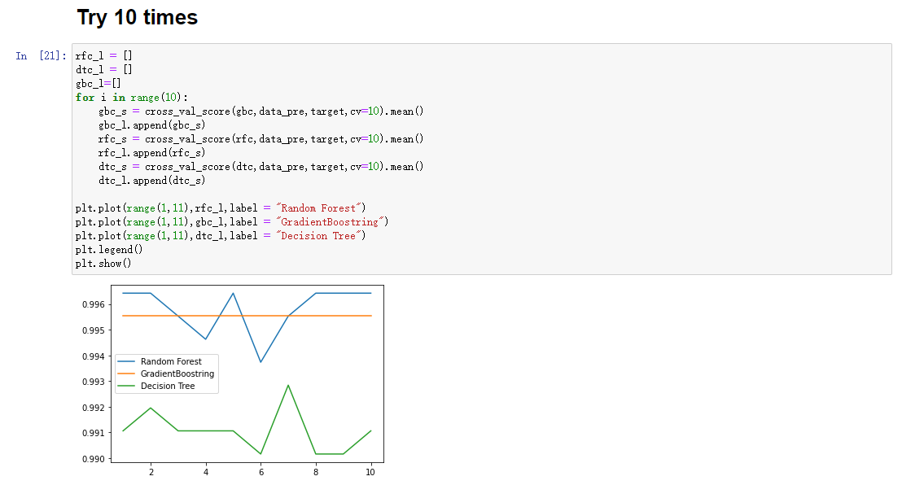
Try more

Slide 14
When and Which Model
Nearest Neighbors
Suitable for small data sets, it is a good standard model and easy to explain.
Linear Models
Very reliable preferred algorithm, suitable for very large data sets and high-dimensional data.
Naive Bayes
It is only applicable to classification problems. It is faster and wider than the linear model. It is applicable to very large data sets and high-dimensional data. The accuracy is usually lower than the linear model.
Decision Trees
It is fast, does not need data scaling, can be visualized and easy to explain.
Random Forest
It is almost always better than a single decision tree, with good robustness and strong performance. No data scaling is required. Not applicable to high-dimensional sparse data.
Gradient Boostring
The accuracy is usually slightly higher than that of random forest. Compared with random forest, the training speed is slower, but the prediction speed is faster and requires less memory. More parameter adjustment is needed than random forest.
Support Vector Machines
It is powerful for medium-sized data sets with similar feature meanings. It requires data scaling and is sensitive to parameters.

Slide 15
Thank you for listening

